Slide 1
Web322 - Assignment1
Dongchan Oh (#128975190)

Slide 2
Table of Contents
Express web server set up
Route Handlers Implementation
Home Page
Meal Package Listing page
Registration Page
Login Page

Slide 3
Express web server set up
npm init
npm install express
Create server
(main.js)
var express = require("express");
var app = express();
var HTTP_PORT = process.env.PORT || 8080;
// call this function after the http server starts listening for requests
function onHttpStart() {
console.log("Express http server listening on: " + HTTP_PORT);
}
app.listen(HTTP_PORT, onHttpStart);

Slide 4
Route Handlers Implementation
create a “views” folder for our HTML files inside the working (open) folder
add a new require for the path module
add the new .html pages
make routes and use the sendFile method
var path = require("path");
/node_modules
/views
home.html
customerRegistration.html
login.html
mealsPackagePage.html
main.js
package.json
// setup another route to listen on /home
app.get("/home", function (req, res) {
res.sendFile(path.join(__dirname, "/views/home.html"));
});

Slide 5

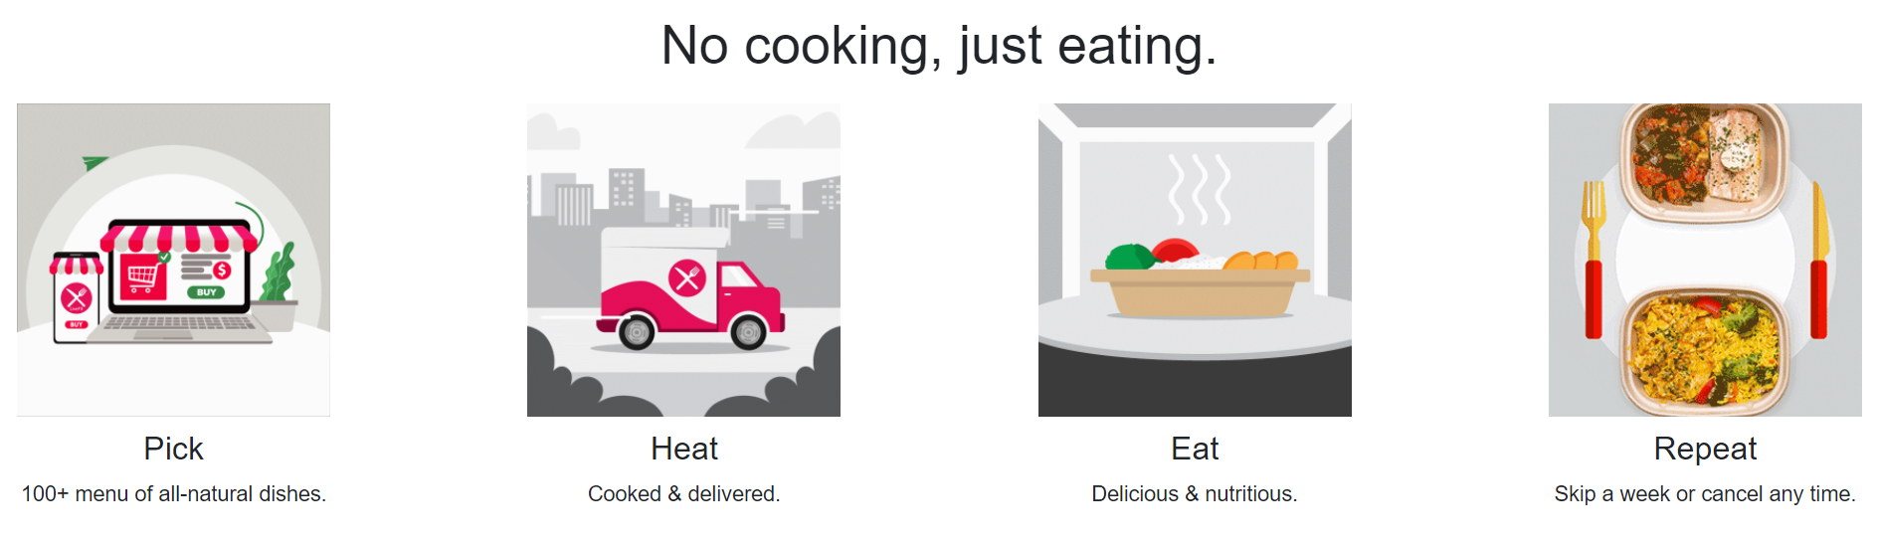
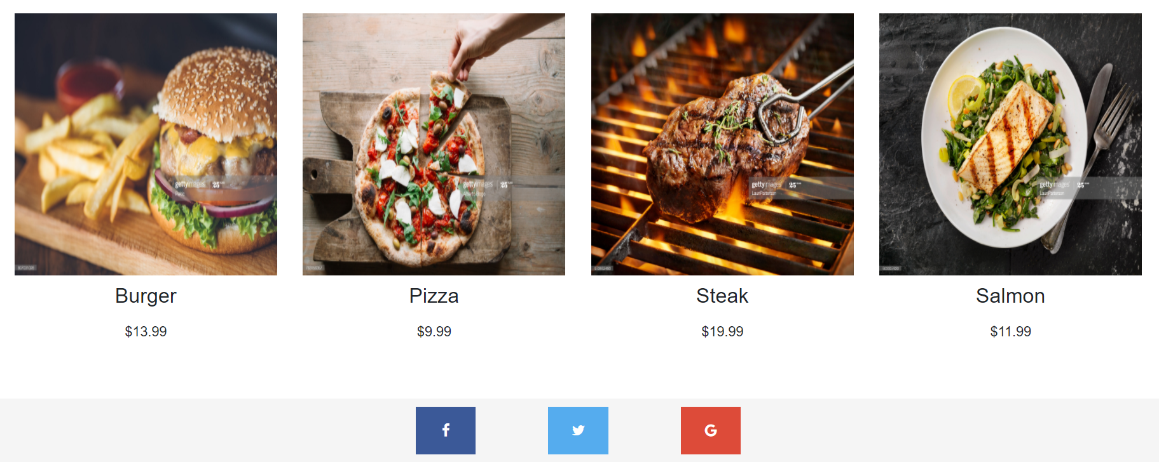
Home Page (1/2)
Using Bootstrap
Header
Navigation bar
Hero Section
Content Section
Top-meal Package
Footer

Slide 6
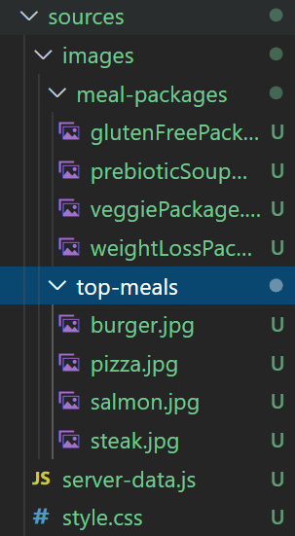
Home Page (2/2)
Serving static files
// setup the static folder that static resources can load from
// like images, css files, etc.
var dir = path.join(__dirname, "/sources");
app.use(express.static(dir));

Slide 7
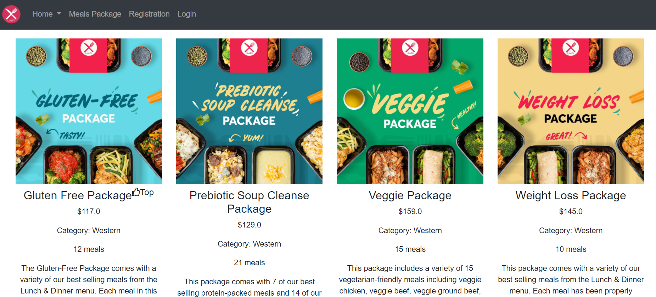
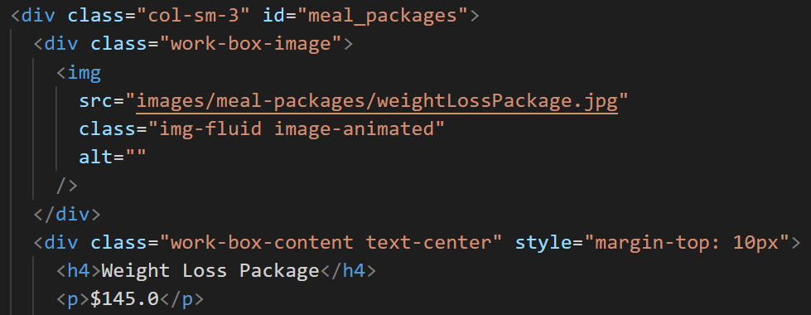
Meal Package Listing page (1/2)
Meal Packages Listing in a grid
4 sample meal packages within a 4 column grid layout
Every meal package have (1)image, (2)title, (3)price, (4)food category, (5)number of meals, (6)synopsis of the content, (7)boolean attribute indicating if it is a top package

Slide 8
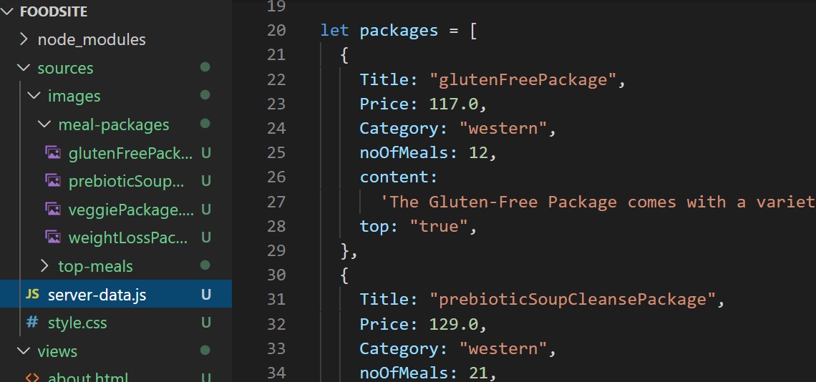
Meal Package Listing page (2/2)
Data for this section must is static.
I defined the data in a separate module (JavaScript file).

Slide 9
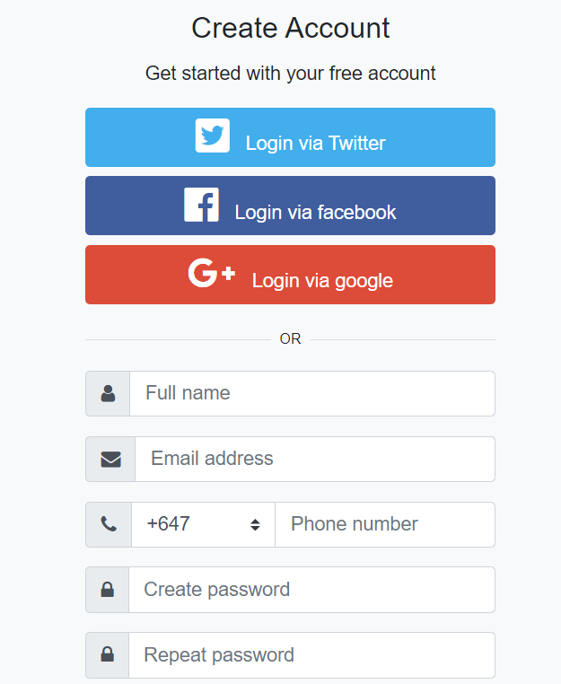
Registration Page
This is implemented as an entirely new page.
The page maintains consistency regarding its structure, header, nav, hero section, footer, and etc as the home page.

Slide 10
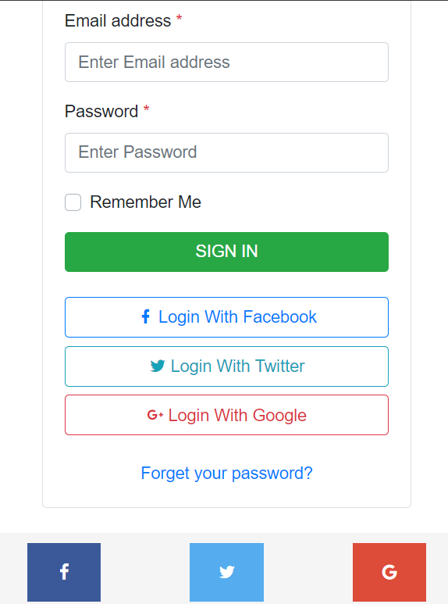
Login Page
This is implemented as an entirely new page.
The page maintains consistency regarding its structure, header, nav, hero section, footer, and etc as the home page.

Slide 11
Thank you

